Slide 1
OPTIC and Art as Argument
Module 3, Source Evaluation

Slide 2

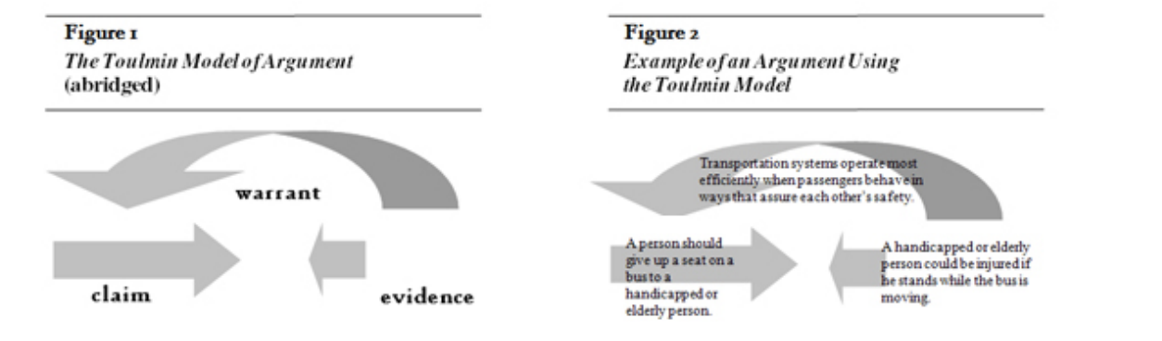
National Writing Project: “Viewing a Poem as Argument”
(Sara Bauer, 19 September 2008)
“Toulmin Model” for argumentation (will be using to build arguments later on):
Emphasis on what ‘warrants’ an argument
Reminder: ‘warrants’ address the question “what does one need to believe for this argument to be convincing?” [the “underlying principle”]
Successful warrants can apply to additional sets of relevant circumstances
Example:

Slide 3
Applying “Toulmin Model” to Poetry
(Sara Bauer, 19 September 2008)
Poem itself = Evidence
Why poet’s choices = Reasoning (e.g., word choice, line length, repetition, structure, imagery, etc.)
Message/Theme = claim
Goal? What warrants the poem’s claim, and the choices made to demonstrate it

Slide 4


OPTIC - Analyzing Art-as-Argument
O
= Overview
in a quick statement, what—overall—is the piece about? Note this is subject matter, not the claim
= Parts
Physical/visual/auditory art: patterns, textures, color composition, groupings, shading, positive-to-negative space, etc.
Literary art: rhetorical devices, figurative language, diction, symbolism, imagery, etc.
= Title, Textual reference
what does the title, or any additional heading or messaging, where it exists, contribute to the piece overall?
= Interrelationship
how do the individual parts above relate to each other? Compare/contrast? Dynamic interplay?
= Claim/Conclusion for
how all of the above works toward a central message/argument (the ‘logic’ of the piece, or, what ‘warrants’ it)
P
T
I
C

Slide 5

Translating OPTIC to a Part-A Response
#1: The work’s central claim/thesis/conclusion = “C”
#2: The argument’s structure, how #1 is achieved = “O,” “P,” “T,” and “I”
#3: Evaluating the effectiveness = how well do “O,” “P,” “T,” and “I,” portray “C”?
Return to the normal considerations:
Who is the artist? Credentials for being an authority on this claim?
Who is the intended audience? Why do the identified devices work for that audience?
Does it fulfill its purpose as the kind of art that it is?
Does it work effectively for you even if you are not part of the intended audience?

Slide 6
Review—Considering Type of Argument
Type of Work | Function | Process for Publication | What to Judge
Academic/Professional Research Publication | Methodological study, informative, academic conclusions and perspectives to a specific, learned, and professional audience | rigorous review, multiple steps | Authorial prominence, mitigation of bias, objective standards, rigorous and replicable process, consideration of perspectives and limitations and applicable scope, ethical considerations
Journalistic Publication | Bias-free and objective information on a given event or issue for a public audience; some opinion pieces | Internal review, with consideration for journalistic integrity (ethics) | Authorial prominence, mitigation of bias, objective standards, knowledge of the issue, publisher reputation, ethical considerations, fair representation of perspectives
Public Speeches | Information and persuasion of public perception or a particular audience | Invitation, or process for public standing (reputation); internal review, or not | Speaker reputation, education, relevance on the issue; methods of persuasion, representation of perspectives; use of figurative language
Artistic Representation | Informative, persuasive, self-fulfilling, aesthetic, etc. | Multiple reviews, often multiple submissions to various publishers, at the publisher’s subjective discretion | Figurative language, reputation, and education, connection to the events/issues; personal and public personality and ethicality; honest representation; aesthetic value; emotional appeal to the audience, etc.

Slide 7
Literary Example
Selections from the works of Aldous Huxley:
Point Counter Point: Rampion’s speech about “idiots and machines”
Brave New World: the new-world order
Island: the manifesto, the “Notes on What’s What”
*see introductions to each selection—read, discuss, and annotate for OPTIC in literary work

Slide 8


Audio Example
Bob Dylan’s Song, “Blowin’ in the Wind”
https://www.youtube.com/watch?v=MMFj8uDubsE
Yes, and how many years must a mountain exist
Before it is washed to the sea?
And how many years can some people exist
Before they're allowed to be free?
Yes, and how many times can a man turn his head
And pretend that he just doesn't see?
The answer, my friend, is blowin' in the wind
The answer is blowin' in the wind
Yes, and how many times must a man look up
Before he can see the sky?
And how many ears must one man have
Before he can hear people cry?
Yes, and how many deaths will it take 'til he knows
That too many people have died?
The answer, my friend, is blowin' in the wind
The answer is blowin' in the wind
How many roads must a man walk down
Before you call him a man?
How many seas must a white dove sail
Before she sleeps in the sand?
Yes, and how many times must the cannonballs fly
Before they're forever banned?
The answer, my friend, is blowin' in the wind
The answer is blowin' in the wind
*includes lyrics, recorded song, and visual of live performance; apply OPTIC to all three aspects of the art

Slide 9
Student Practice - Using OPTIC to Practice Argument Analysis
Students will answer Part A questions 1-3 for the art piece and be given an introduction to “The Arsenal”
Students may use their notes on OPTIC, as well as the above chart in their evaluation
Students should reference any provided resource, templates, scripts, or feedback provided on prior Part A practices

